Slide 1

画四色圆
Ablock创客教育
Notes:
更多模板请关注：https://haosc.taobao.com

Slide 2
目录
CONTENTS
01
Part one
知识回顾
02
Part two
画四色圆
03
Part three
实例

Slide 3
01
Part one
知识回顾

Slide 4

知识回顾
如何导入turtle库？
import turtle

Slide 5
知识回顾
设置画笔的颜色为红色
Turtle.color(‘red’)
Color(“red”)
color(“red”)
turtle.color(‘red’)

Slide 6
知识回顾
设置画笔的颜色为红色，填充色为黄色
turtle.color(“yellow”,‘red’)
turtle.color(“yellow”,“red”)
turtle.color(“red”, “red”)
turtle.color(‘red’, ‘yellow’)

Slide 7
知识回顾
绘制圆形是哪个函数？
turtle.circle(100)

Slide 8
知识回顾
开始填充颜色是哪个函数？
turtle.begin_fill()

Slide 9
知识回顾
结束填充颜色是哪个函数？
turtle.end_fill()

Slide 10
02
Part two
画四色圆

Slide 11
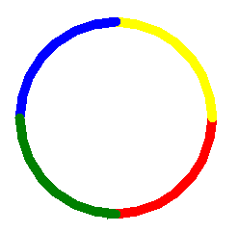
画四色圆
画出以下图形
问题1：如何画1/4个圆？
import turtle
turtle.color("red")
turtle.circle(100, 90)
改变弧度？
弧度

Slide 12
画四色圆
画出以下图形
问题2：如何改变画笔粗细？
import turtle
turtle.pensize(10)
turtle.color("red")
turtle.circle(100, 90)
画笔粗细

Slide 13
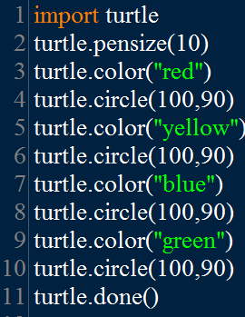
画四色圆
画出以下图形
设置笔的粗细
设置半径和角度

Slide 14
03
Part three
实例

Slide 15
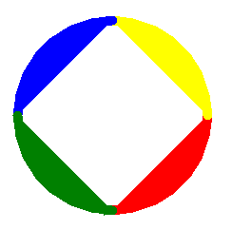
import turtle
turtle.pensize(10)
turtle.color("red", 'red')
turtle.begin_fill()
turtle.circle(100, 90)
turtle.end_fill()
turtle.color("yellow","yellow")
turtle.begin_fill()
turtle.circle(100, 90)
turtle.end_fill()
turtle.color("blue","blue")
turtle.begin_fill()
turtle.circle(100, 90)
turtle.end_fill()
turtle.color("green","green")
turtle.begin_fill()
turtle.circle(100, 90)
turtle.end_fill()
画四色圆

Slide 16
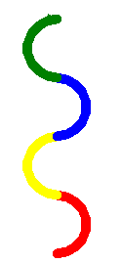
画四色圆
画出以下图形
import turtle
turtle.pensize(10)
turtle.color("red", 'red')
turtle.circle(30, 180)
turtle.color("yellow","yellow")
turtle.circle(-30, 180)
turtle.color("blue","blue")
turtle.circle(30, 180)
turtle.color("green","green")
turtle.circle(-30, 180)

Slide 17

画四色圆
画出以下图形
import turtle
turtle.pensize(10)
turtle.color("red", 'red')
turtle.circle(30, 180)
turtle.color("yellow","yellow")
turtle.circle(-30, 180)
turtle.color("blue","blue")
turtle.circle(-30, 180)
turtle.color("green","green")
turtle.circle(30, 180)

Slide 18
总结
circle(半径, 弧度）
可调整画笔的粗细
begin_fill()和end_fill() 可以用于填充颜色

Slide 19
THANK YOU
教师：赵老师

